Slide 1
Socket Programming

Slide 2
Sockets Programming
Client-Server Computing
What are Sockets
Sockets Programming in Java
Programming Examples

Slide 3
Client/Server Computing
Simple idea:
Some hosts (clients, typically desk top computers) are specialized to interact with users:
  Gather input from users
  Present information to users
Other hosts (servers) are specialized to manage large data, process that data
The Web is a good example: Client (Browser) & Server (HTTP server)

Slide 4



Client/Server Computing
Other examples:
  E-mail
Server
Client
Client

Slide 5

Client/Server Computing
Other examples:
  Chatroom

Slide 6
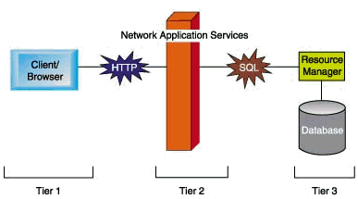
Tiered Client/Server Architecture
1-tier: single program
2-tier: client/server (e.g. the Web)
3-tier: application logic and databases on different servers (e.g. the Web with CGI and databases)

Slide 7
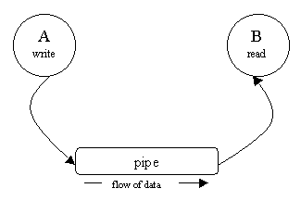
Client/Server Communication
Two related processes on a single machine may communicate through a pipe
A pipe is a pseudo-file that can be used to connect two processes together

Slide 8
Client/Server Communication
Two UNRELATED processes may communicate through files (process A write to a file and process B reads from it)
But HOW two processes located on two different machines communicate? Solution: Berkeley sockets.

Slide 9
What are sockets
A socket is an end point of a connection
Or: the interface between user and network
Two sockets must be connected before they can be used to transfer data (case of TCP)
A number of connections to choose from:
  TCP, UDP, Multicast
Types of Sockets
  SOCK_STREAM, SOCK_DGRAM, SOCK_RAW

Slide 10
Sockets
Message destinations are specified as socket addresses
Each socket address is a communication identifier:
  Internet address
  Port number
The port number is an integer that is needed to distinguish between services running on the same machine
Port numbers between 0 .. 1023 are reserved

Slide 11
Ports
Some “well-known” ports:
  21: ftp
  23: telnet
  80: http
  161: snmp
Check out /etc/services file for complete list of ports and services associated to those ports

Slide 12
Which transport protocol (TCP v. UDP)
TCP -- Transmission Control Protocol
UDP -- User Datagram Protocol
What should I use?
  TCP is a reliable protocol, UDP is not
  TCP is connection-oriented, UDP is connectionless
  TCP incurs overheads, UDP incurs fewer overheads
  UDP has a size limit of 64k, in TCP no limit

Slide 13
Unix and C specific data structures
The <netdb.h> library provides the following data structures:
struct hostend { // for host info
char *h_name;
char **h_aliases;
int h_addrtype;
int h_length;
char **h_addr_list;
#define h_addr h_addr_list[0]
};

Slide 14
Unix and C specific data structures
struct servend { //service info
char *s_name;
char **s_aliases;
int s_port;
char *s_proto;
};

Slide 15
Unix and C specific data structures
The following functions return information about a given host or service:
struct hostend *gethostbyname (char *hostname)
struct servend *getservbyname (char *service, char *protocol)

Slide 16
UDP Socket programming
UDP is simple and efficient, but not reliable
Communication takes place in a symmetric manner: both ends send and receive messages following an agreed upon protocol

Slide 17
UDP Socket Programming
Since no connection is created, each message should contain the address of the recipient.
In Java, messages are contained in instances of class DatagramPacket

Slide 18
The DatagramPacket class
Constructors:
  One for sending datagrams:
  DatagramPacket{byte buffer[], int length, InetAddress, int port}
  One for receiving datagrams:
  DatagramPacket{byte buffer[], int length}

Slide 19
The DatagramPacket class
The useful methods are the accessors:
InetAddress getAddress()
Int getPort()
Byte[] getData()
Int getLength()

Slide 20
Sending and receiving Datagram packets: using sockets
Both ends need to create sockets to communicate
Sockets will be “bound” to a given host and port number
The receiver needs to “listen” on a port number that is known by the sender
The sender can a priori use any port number

Slide 21
The DatagramSocket class
Constructors:
  One for the sender (randomly chosen port number):
  DatagramSocket() throws SocketException
  One for the receiver (port needs to be specified):
  DatagramSocket(int port) throws SocketException

Slide 22
The DatagramSocket class
Sending and receiving messages:
void send(DatagramPacket packet) throws IOException
void receive(DatagramPacket packet) throws IOException
Close the socket when you’re done!
void close()

Slide 23
Receiving UDP packets
DatagramSocket socket = new DatagramSocket(port);
Byte buffer[] = new byte[65508];
DatagramPacket packet = new DatagramPacket(buffer, buffer.length);
Socket.receive(packet);
InetAddress fromAddress = packet.getAddress();
int fromPort = packet.getPort();
int length = packet.getLength();
byte[] data = packet.getData();
socket.close();

Slide 24
Sending UDP Packets
DatagramSocket socket = new DatagramSocket();
DatagramPacket packet = new DatagramPacket(data, data.length, InetAddress.getByName(“eureka.sce.carleton.ca”), 1728);
socket.send(packet);
socket.close();

Slide 25
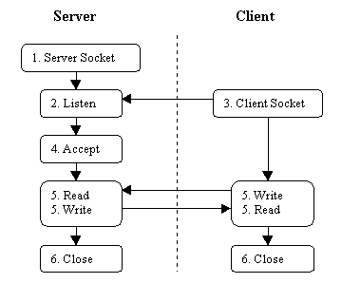
TCP Socket Communication
Sequence of steps normally taken to set up socket communication and exchange data between C/S

Slide 26
Sockets Programming in Java
Streams
  The basic of all I/O in Java is the data stream
  A pipeline of data
    put info into the pipeline (write) and get it (read)
Programming with Sockets (TCP)
  Opening a Socket
  Creating a data input stream
  Creating a data output stream
  Closing the socket(s)

Slide 27
Opening a socket
Client-side:
Socket myClient = null;
  try {
  MyClient = new Socket(“host”, PotNumber);
  } catch (UnknownHostException uhe) {
  uhe.printStackTrace();
  }
“host” can be symbolic name or IP address

Slide 28
Opening a socket
Server-side
ServerSocket myService = null;
try {
myService = new ServerSocket(portNumber);
} catch (UnknownHostException uhe) {
uhe.printStackTrace();
}
Socket serviceSocket;
serviceSocket = myService.accept();

Slide 29
Creating an input stream
Client-side:
BufferedReader is = null;
try {
is = new BufferedReader(new
InputStreamReader(myClient.getInputStream()));
} catch (IOException ioe) {
ioe.printStackTrace();
}

Slide 30
Creating an input stream
Server-side:
BufferedReader is = null;
try {
is = new BufferedReader(new
InputStreamReader(serviceClient.getInputStream()));
} catch(IOException ioe) {
ioe.printStackTrace();
}

Slide 31
Creating an output stream
Client-side:
DataOutputStream os = null;
try {
os = new
DataOutputStream(myClient.getOutputStream());
} catch (IOException e) {
e.printStrackTrace();
}

Slide 32
Creating an output stream
Server-side:
DataOutputStream os = null;
try {
os = new
DataOutputStream(serviceClient.getOutputStream());
} catch(IOException e) {
e.printStackTrace();
}

Slide 33
Closing sockets
Client-side:
try {
os.close();
is.close();
myClient.close();
} catch(IOException e) {
e.printStrackTrace();
}

Slide 34
Closing sockets
Server-side:
try {
os.close();
is.close();
serviceSocket.close();
myService.close();
} catch(IOException e) {
e.printStackTrace();
}

Slide 35
An Example
See the “Counter” class example

Slide 36
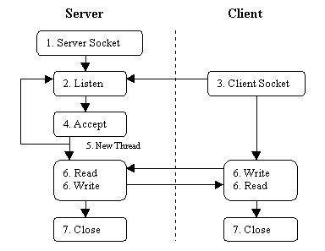
Multi-threaded Servers
A server should be able to serve multiple clients simultaneously

Slide 37
Multi-threaded Servers
See the MTEchoServer example

